Slide 1





SMART ATTENDANCE SYSTEM
Vishal M - 43130487

Slide 2
The Smart Attendance System is a web-based application designed to simplify and automate the process of tracking student attendance.
It enables faculty to mark, view, and manage attendance records digitally.
The system provides an easy-to-use dashboard where users can add student details, take attendance, and view daily summaries.
Data is stored securely using MongoDB for efficient retrieval and management.
Abstract

Slide 3
In the traditional attendance system, faculty manually mark attendance on paper, which can lead to errors, data loss, and time consumption.
Retrieving past attendance records is also tedious and inefficient.
Manual systems lack accuracy, instant updates, and centralized data access.
Existing System

Slide 4
In the traditional attendance system, faculty manually mark attendance on paper, which can lead to errors, data loss, and time consumption.
Retrieving past attendance records is also tedious and inefficient.
Manual systems lack accuracy, instant updates, and centralized data access.
Proposed System

Slide 5
Advantages
1
Reduces manual effort and errors
2
Provides instant attendance reports
3
Secure and centralized data storage using MongoDB
4
Saves time and increases productivity

Slide 6
Disadvantages
1
Requires internet connectivity
2
System failure can cause temporary inaccessibility
3
Limited offline support

Slide 7





Hardware Requirements
Processor: Intel i3 or higher
RAM: 4 GB minimum
Hard Disk: 250 GB minimum
Internet connection

Slide 8
Software Requirements
1
Frontend: HTML, CSS, JavaScript
2
Backend: Node.js / Express.js
3
Database: MongoDB
4
OS: Windows / macOS / Linux
5
Browser: Chrome / Edge

Slide 9
Modules
Home Module: Displays system overview and navigation
Add Student Module: Allows user to register student details (Name, Roll Number)
Take Attendance Module: Enables marking attendance and check-in/check-out.
View Attendance Module: Displays total students and current attendance status.

Slide 10
Module Description
Home Page
Dashboard
Take Attendance
Introduction and navigation options for the user.
Displays total students, attendance count, and system actions.
Faculty can mark check-in and check-out.
View Attendance
Add Student
Displays student list and attendance report with timestamps.
New students can be registered for attendance tracking.

Slide 11
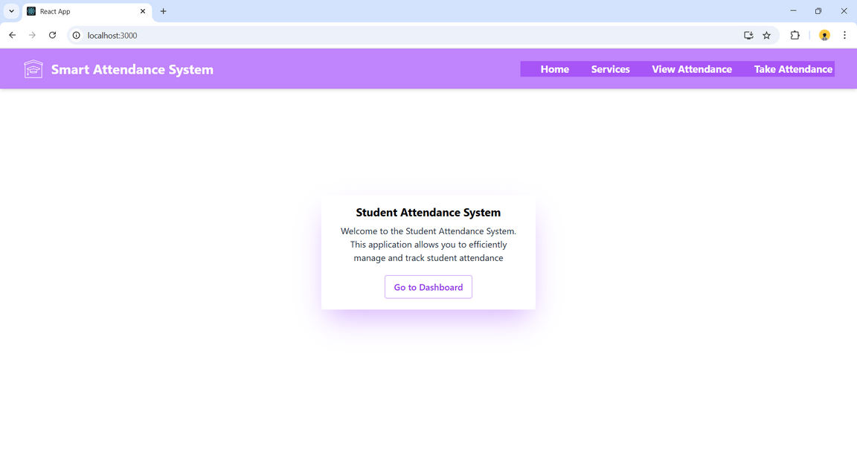
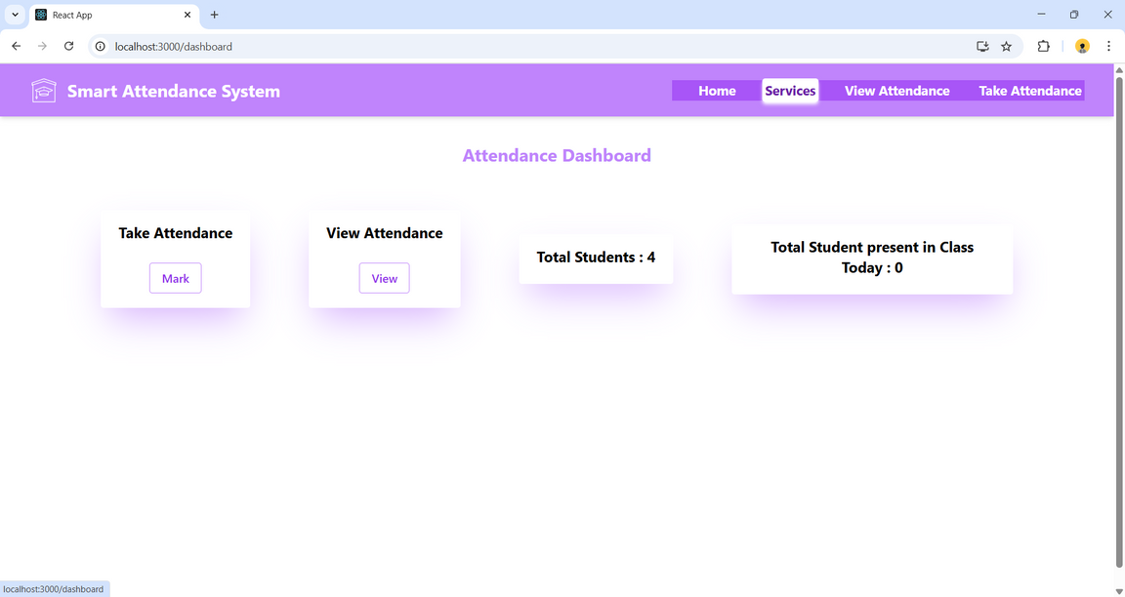
Sample Output
Homepage
Dashboard

Slide 12
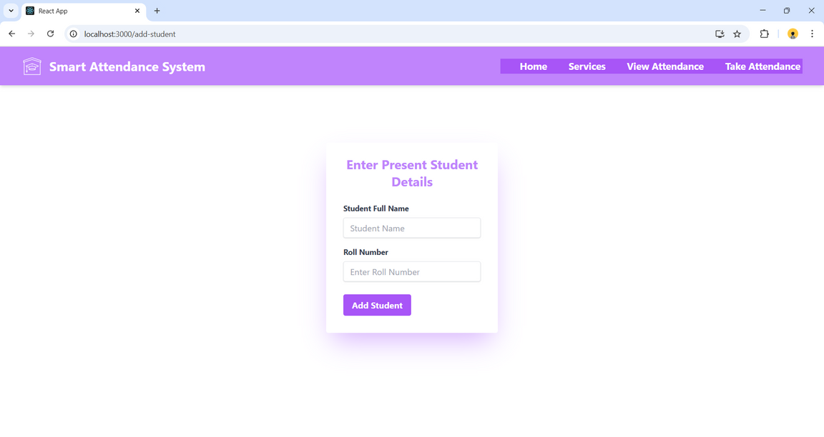
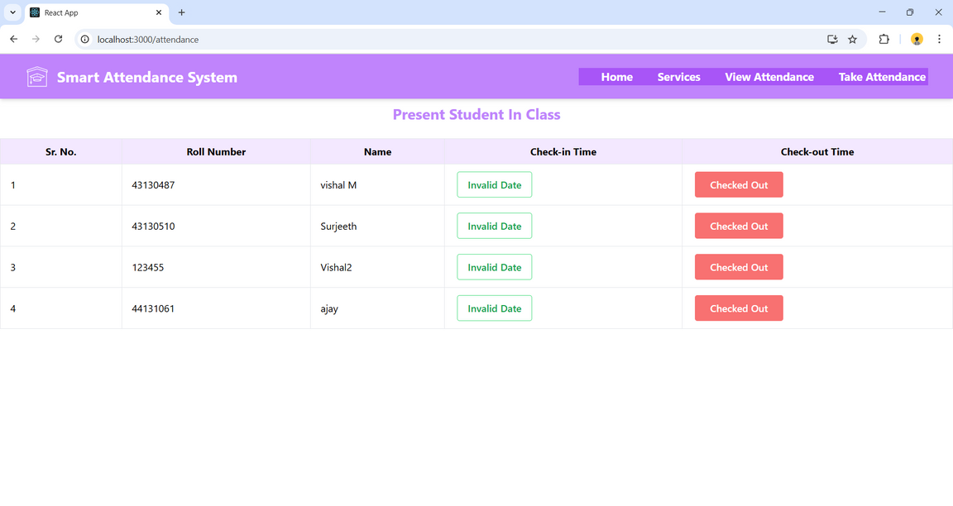
Sample Output
Add Student
View Attendance

Slide 13
Conclusion
The Smart Attendance System successfully replaces manual attendance management with an automated, efficient, and user-friendly web application.
It ensures accuracy, reduces workload, and provides a digital record of attendance using modern web technologies.

Slide 14
End
Thank you
Do you have any questions?

